Slide 1




IoT Remote vehicle for Hazardous Zone Exploration
Team ID – CU_CP_Team_10170
N. Rishi varun
A. Srikanth
Under the mentorship of
-Sumit sunil Sartale

Slide 2

Project Objectives
Problem Statement
Analysis of our survey
Project Overview – Introduction
Technologies Used
End Users
Wow Factor in Project
Flow of Project
Result
Conclusion
Future Perspective

Slide 3
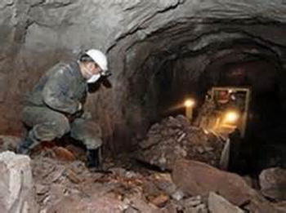
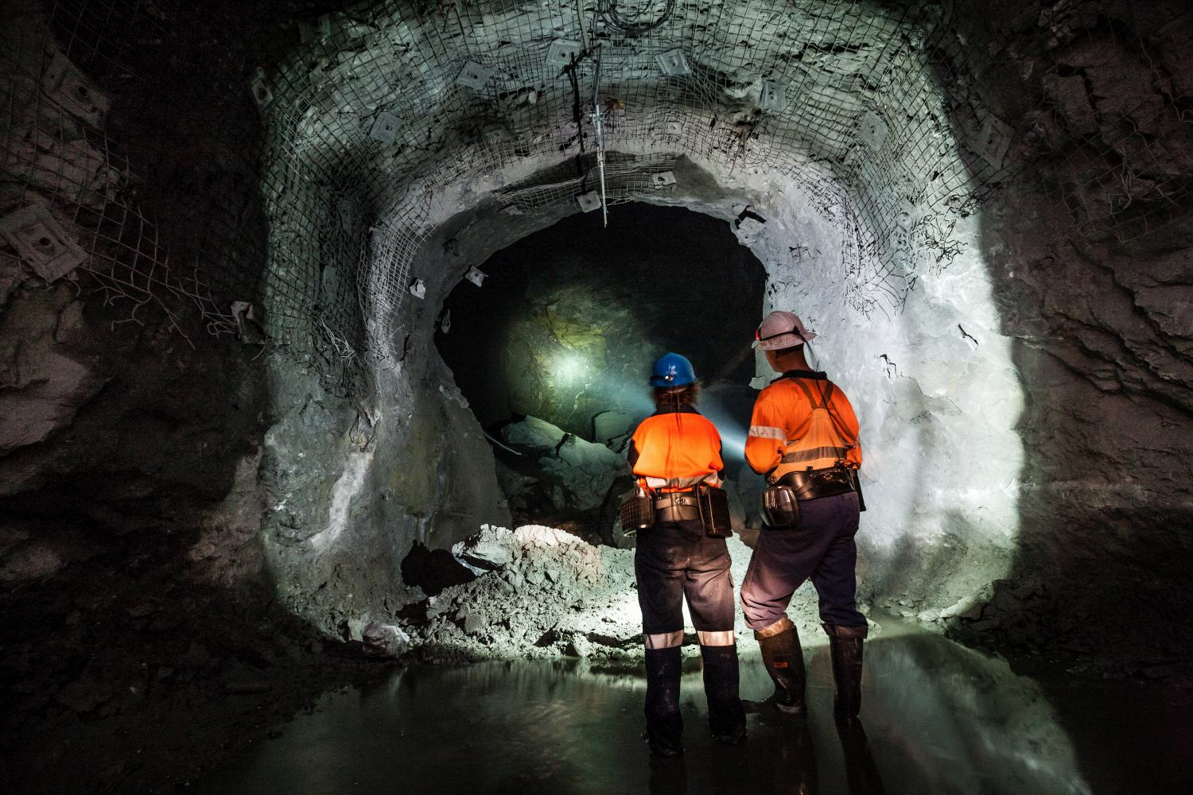
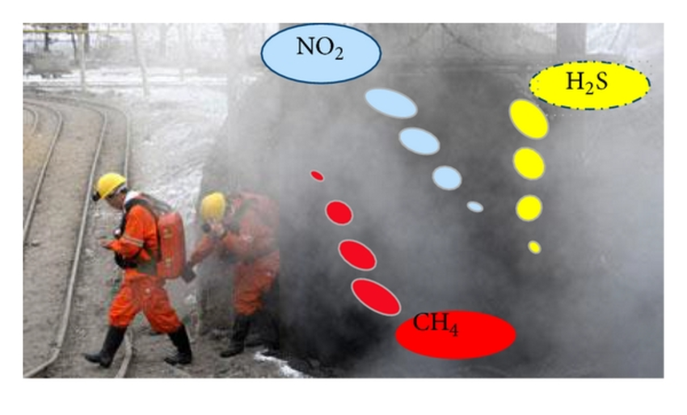
Problem Statement
  Safety Risks: Mining areas and other hazardous zones pose dangers such as toxic gases and extreme temperatures, making it unsafe for humans.
  Limited Human Accessibility: Certain areas in mines or disaster zones are too dangerous or difficult for direct human entry.
  Real-time Monitoring: Lack of an effective system to remotely monitor environmental conditions like gas levels, temperature, and structural integrity.
  Communication Issues: Traditional methods may not provide a reliable communication system for controlling vehicles in remote locations.

Slide 4
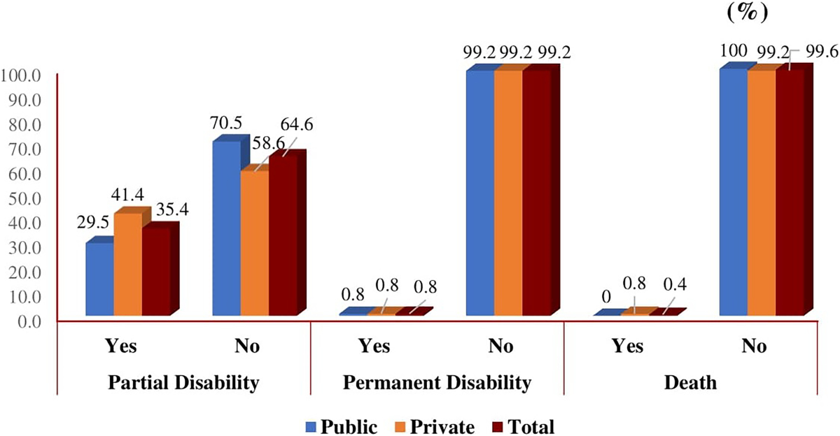
Analysis of our Survey :-

Slide 5
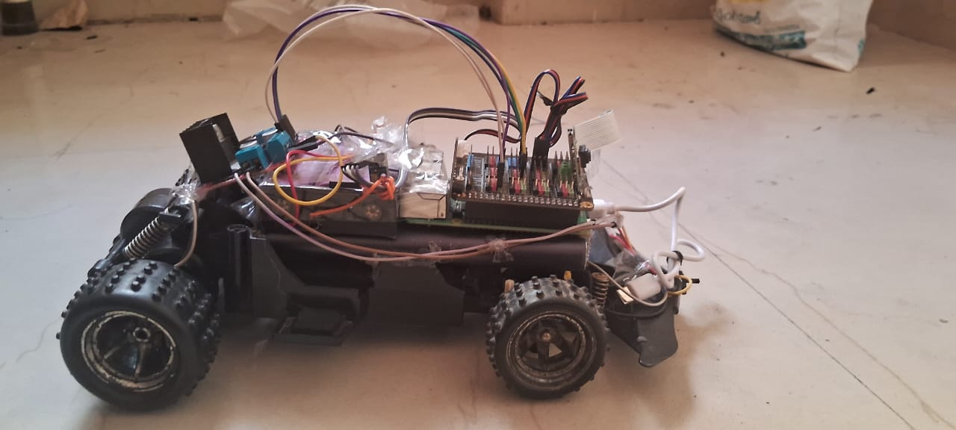
Project overview - Introduction
  The sensors that are used to measure the levels of temperature, methane, carbon monoxide, and pressure in the mine. The data from these sensors is then sent to a central control system, which can be used to monitor the mine environment in real time.
  In addition to the sensors and control system, our project also includes a live monitoring system. This system allows the mine manager to view the data from the sensors in real time, from anywhere in the world. This allows the manager to quickly identify any potential hazards and take steps to address them.

Slide 6
Technologies Used :-
Hardware Components:-
Raspberry Pi (Microcontroller)– Raspberry Pi 4 Model B
Motor Driver Module – L298N Dual H-Bridge
Temperature Sensor – LM35
Methane Sensor – MQ-4
Carbon Monoxide Sensor – MQ-7
Barometer Sensor – BMP280
Power Bank – 5V, 10000mAh
Software & Programming:-
Python (For sensor data processing and vehicle control)
Thing Speak (For remote monitoring and Data Visualization)
Linux OS (Running on Raspberry Pi)

Slide 7
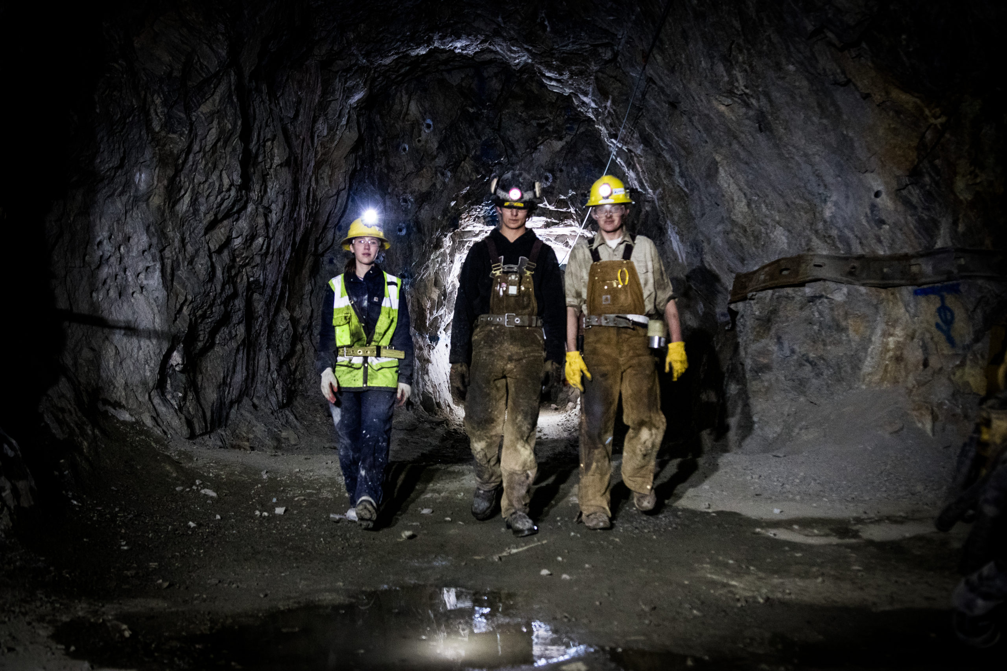


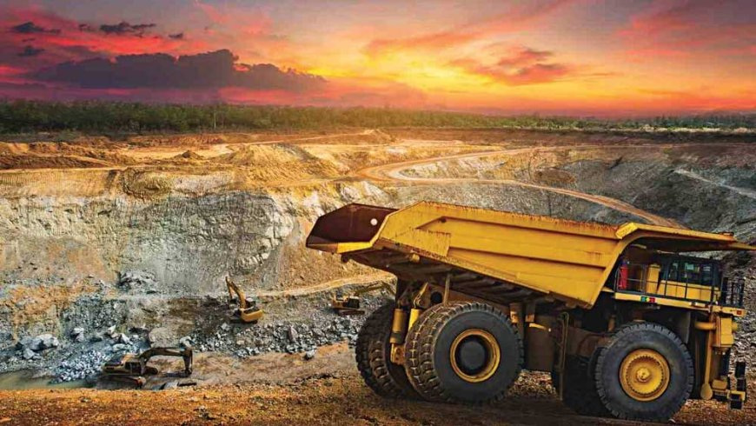
End User
Mining Companies – To ensure worker safety and monitor hazardous mining environments in real time.
Disaster Response Teams – For search and rescue operations in disaster-affected areas like collapsed mines or chemical spill zones.
Environmental Agencies – To monitor air quality, gas emissions, and atmospheric conditions in hazardous zones.

Slide 8
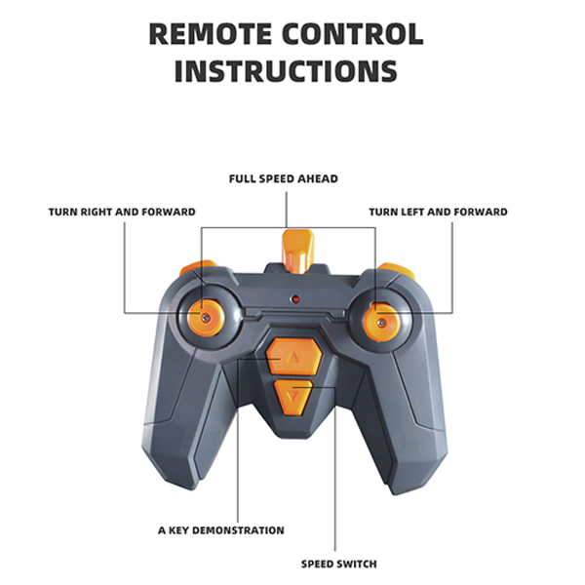
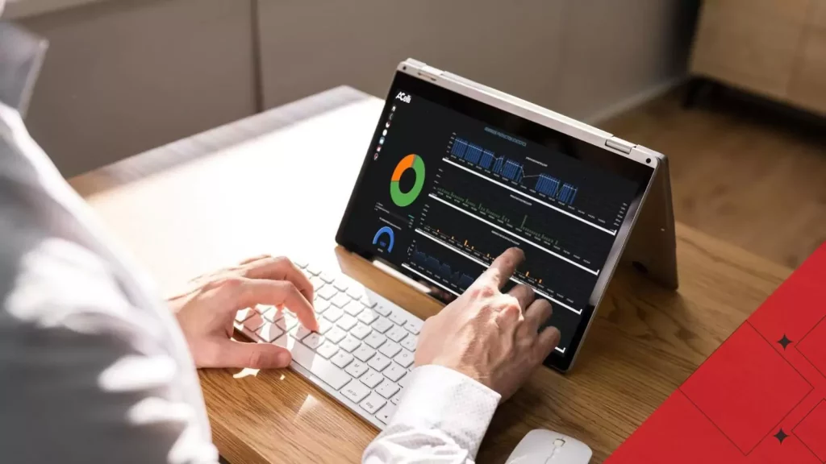
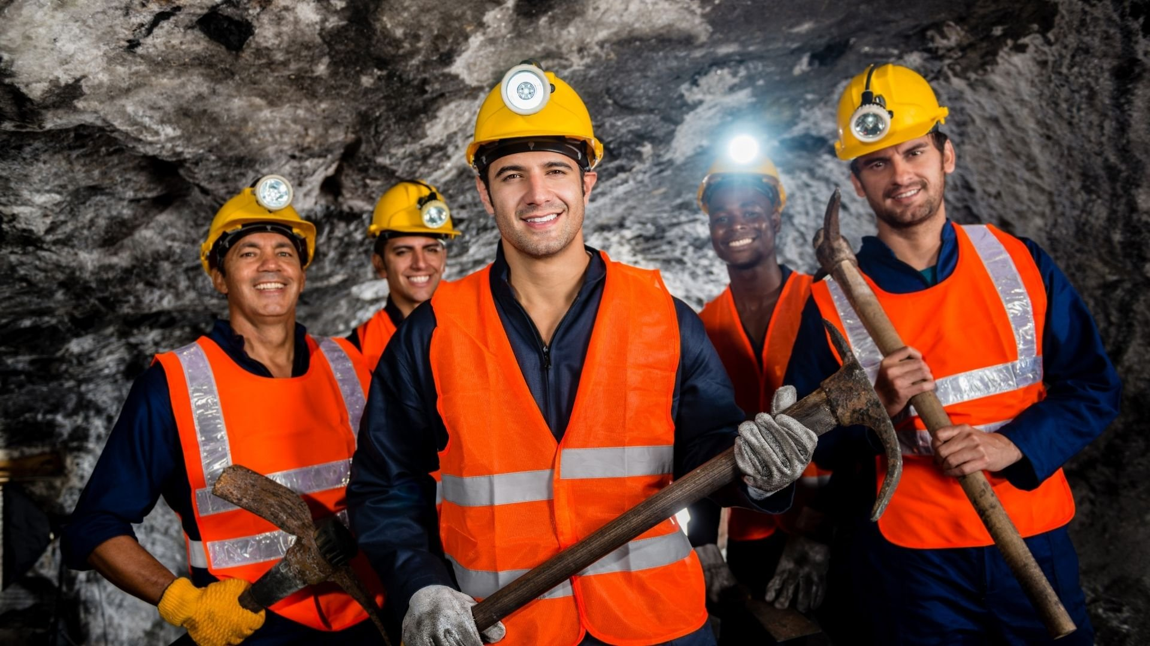

Wow Factor in Solution
Fully Remote-Controlled Exploration
Real-Time Hazard Detection & Monitoring
IoT-Enabled Smart Sensing
Versatile Applications Beyond Mining
Cost-Effective & Scalable Solution
Enhanced Worker Safety

Slide 9
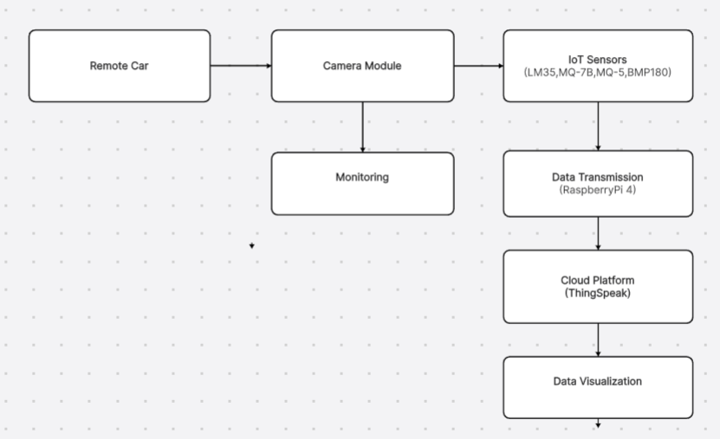
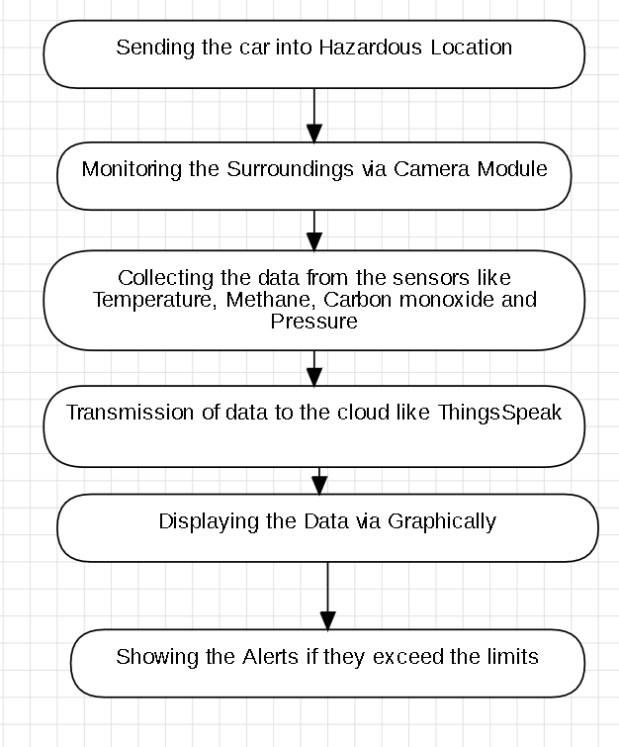
Modelling
Flowchart
Workflow

Slide 10
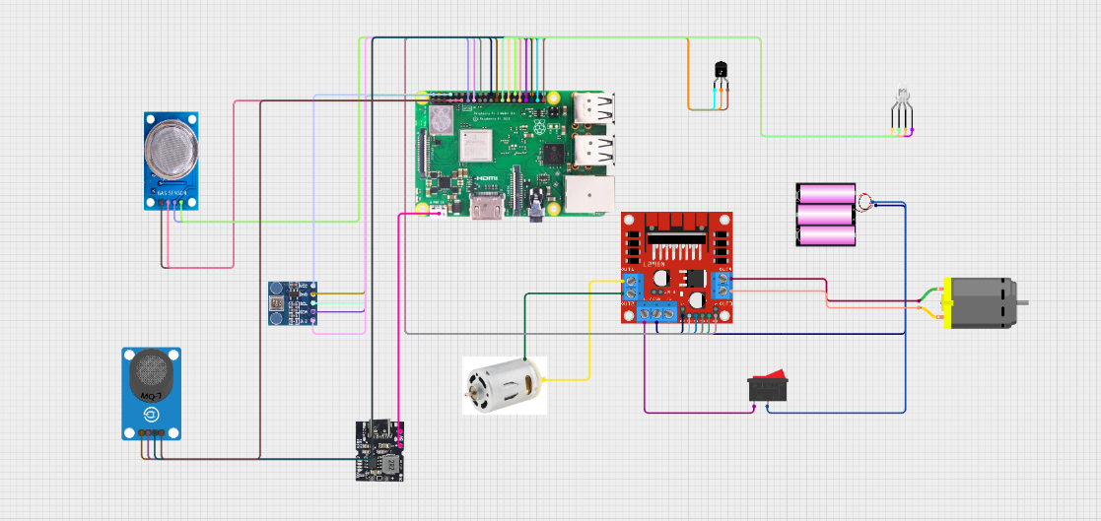
Circuit Model
Modelling

Slide 11
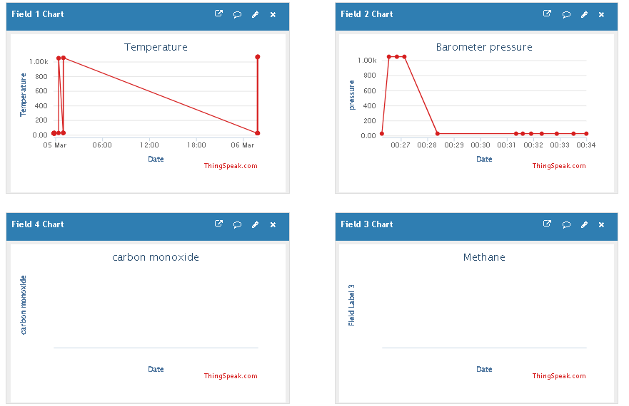
Result
Controlled remotely via IDE commands, ensuring safe exploration.
Live data transmission from temperature, methane, CO, and barometric sensors.
Alerts triggered for toxic gas presence, extreme temperatures, and unstable conditions.
Seamless IoT connectivity, ensuring uninterrupted monitoring.
Minimized human exposure to hazardous environments.

Slide 12
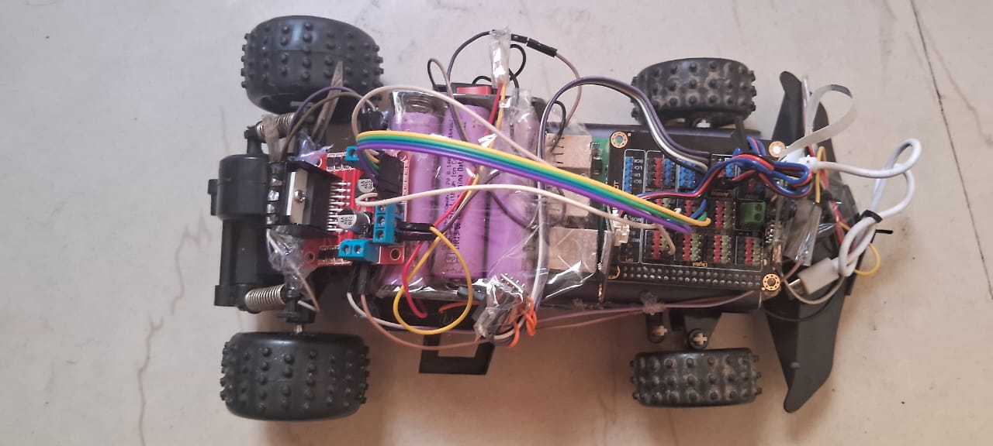
Outcomes
Link:- Project Demo Video Link

Slide 13
Conclusion
Safe and Efficient Exploration – Minimizes risks by allowing remote operation.
Real-Time Hazard Detection – Instantly detects toxic gases, temperature fluctuations, and pressure changes.
Seamless IoT Integration – Ensures stable data transmission for better decision-making.
Scalability for Future Enhancements – Can be upgraded with AI, automation, and data storage for predictive analysis.

Slide 14
Future Perspective
AI and Automation : AI analyzes sensor data to detect anomalies and trigger automatic safety measures. It predicts potential hazards and controls equipment to prevent accidents.
Cloud Storage and Data Analysis : Sensor data is securely stored in the cloud and accessible anytime. Data is processed in real-time to generate analytical insights and reports.
Better Communication and Control(LORA) : LoRa enables long-range, low-power communication between sensors and the control system. It ensures reliable data transmission and remote-control capabilities.
More Sensors and Features Temperature, methane, carbon monoxide, and pressure sensors monitor critical parameters. These sensors help detect hazardous conditions and ensure safety.

Slide 15
Thank You…!
i
22
Notes:
15

